Slide 1
Improving exposure assessment methodologies for occupational epidemiological studies on pesticides
John Cherrie

Slide 2
Introduction…
Pesticides are intrinsically harmful, and are therefore closely regulated
Regulation focusses on products and specific active ingredients
In agriculture many different pesticides and other chemicals are used
Use has changed over time and between countries

Slide 3
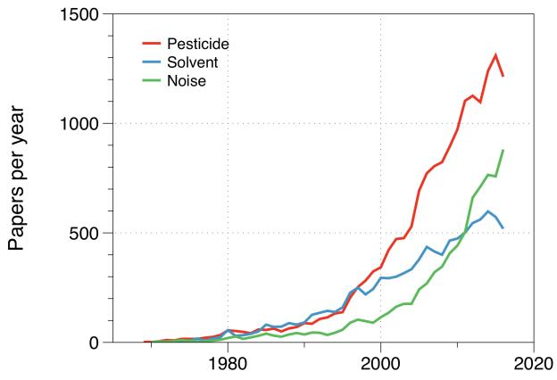
Introduction…
There is increasing interest in epidemiological studies of pesticide exposed workers
For chronic diseases retrospective exposure assessment is challenging
Historic measurement data not really available
Estimation methods have generally not been validated
Search in Scopus for…
pesticide AND epidemiology AND ( work OR occupational )

Slide 4
Our aims…
The IOM, HSL, IRAS and the University of Manchester are collaborating on a new study to better understand the reliability of assessment of human exposure to pesticides in previous occupational epidemiological investigations, and to use this information to recommend improvements in scientific practice for the future.

Slide 5
Our questions for this mini-symposium…
What methods have you successfully used epidemiological studies?
What were the difficulties you encountered/weaknesses?
What improvements could be made, both in methodologies and in data availability?
How should the planned research best interact with the occupational epidemiology community?

